Slide 1
Prediction of Bike Buyers

Slide 2
Objective
The main objective is to predict whether a person will buy a bike or not using the given information of a person like Age, Gender, Location, Occupation etc.
Workflow
Classifying: We may want to classify or categorize our samples. We may also want to understand the implications or correlation of different classes with our solution goal.
Converting: For modeling stage, one needs to prepare the data. Depending on the choice of model algorithm one may require all features to be converted to numerical equivalent values. So for instance converting text categorical values to numeric values.
Completing: Data preparation may also require us to estimate any missing values within a feature. Model algorithms may work best when there are no missing values.
Charting: How to select the right visualization plots and charts depending on nature of the data and the solution goals.

Slide 3
Analyzing dataset
Categorical Variable:
These values classify the samples into sets of similar samples. Within categorical features are the values nominal, ordinal, ratio, or interval based? Among other things this helps us select the appropriate plots for visualization.
Categorical: Marital Status, Gender, Education, Occupation, Home Owner, Region, City, Zip code, Country . Ordinal: Commute Distance
Numerical Variable:
Which features are numerical? These values change from sample to sample. Within numerical features are the values discrete, continuous, or time series based? Among other things this helps us select the appropriate plots for visualization.
Continuous: Age, Latitude, Longitude, Yearly Income. Discrete: Children, Cars.
Target Variable:
The Variable which need to be predicted is BikeBuyer

Slide 4
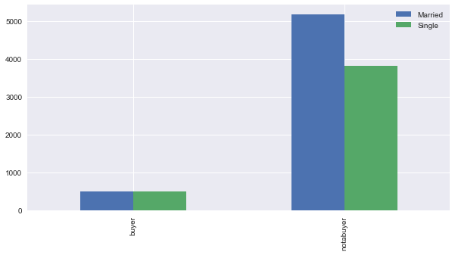
Exploratory data analysis of features using charts
1. Marital Status Vs BikeBuyer￼￼￼
Both Married and Single are more likely to buy the bike

Slide 5
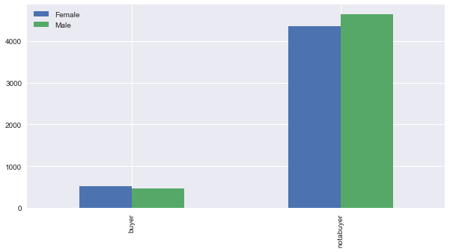
2. Gender Vs BikeBuyer
Female are more likely to buy bike than Male

Slide 6
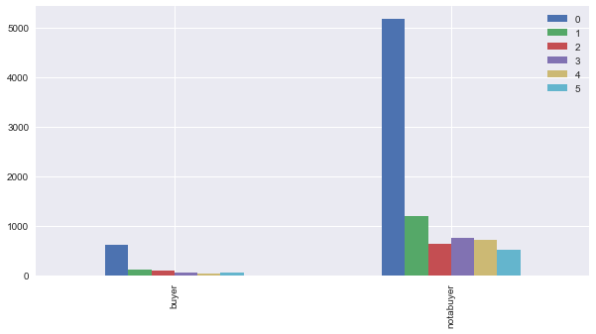
3. Children Vs BikeBuyer
Person with no children are more likely to buy bike than others

Slide 7
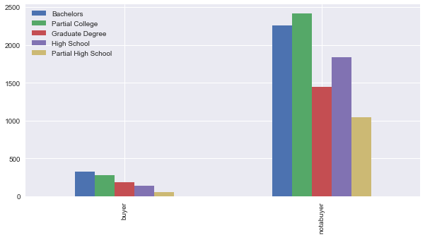
4. Education Vs BikeBuyer
Bachelors are more likely to buy bikes than others

Slide 8
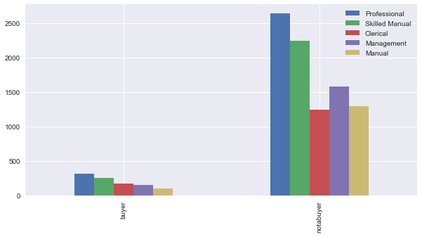
5. Occupation Vs BikeBuyer
Professionals are more likely to buy bike

Slide 9
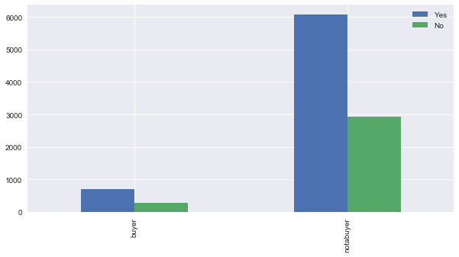
6. Home Owner Vs BikeBuyer
People who own home are more likely to buy bike than others

Slide 10
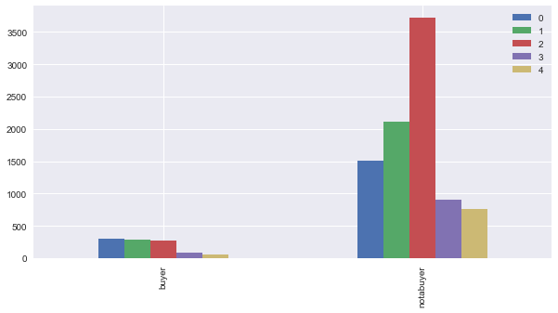
6. Cars Vs BikeBuyer
People who have no cars are likely to buy bike than others

Slide 11
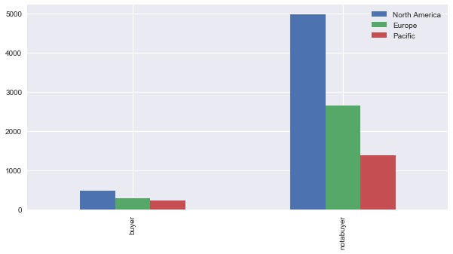
7. Region Vs BikeBuyer
People who belongs to North America region are more likely to buy cars than others.

Slide 12
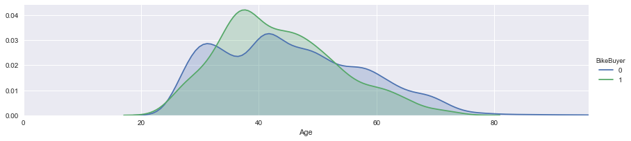
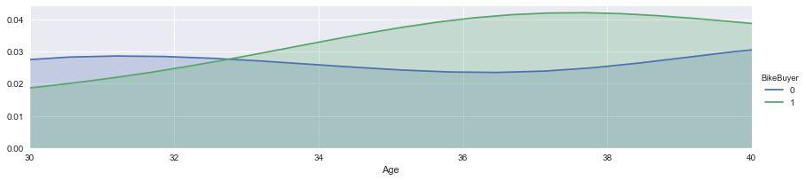
8. Age Vs BikeBuyer
Scaling in the range 30 to 40

Slide 13
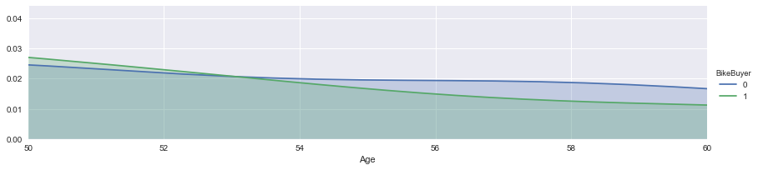
Scaling in the range 50 to 60
People who are in the range 33 to 53(approx.) are more likely to buy bike. Also, 0 indicates ‘No’ and 1 indicates ‘Yes ‘

Slide 14
Conclusion
Hence from the above analysis we can conclude that a irrespective of the Marital status a bachelor professional female who belongs to North America region and who belongs to the age in the range of 33 to 53 has no children, no cars and owning a home is more likely to buy bike when compare to other combinations.
Feature Engineering
Feature engineering is the process of using domain knowledge of the data to create features (feature vectors) that make machine learning algorithms work.
There are two main task done in Feature Engineering part
Encoding non numerical values into numerical values
Binning
Imputing null values

Slide 15
Encoding non numerical values into numerical values
Feature need to encoded are: Marital Status, Gender, Education, Occupation, Commute Distance, City, Zip Code and Country.
1.Marital Status
Before encoding:
Married - 5673 records
Single - 4327 records
After encoding:
0 - 5673 records
1 - 4327 records
Similarly based upon number of categories the encoding is done for each feature.

Slide 16
Binning
Features like Age, yearly income are binned by range which helps to derive the higher accuracy
Age
('Age' <= 30) = 0
('Age‘ > 30 and 'Age‘ <= 50) = 1
('Age‘ > 50 'Age' <= 70) = 2
('Age' > 70 'Age' <= 100) = 3
Similarly, yearly income is binned with the specific range and a numeric value is assigned

Slide 17
Imputing null values
The below features are with null values
Latitude, Longitude, City, Zip Code, Country
Since the city, zip code, country are categorical variable the null values imputed as 0 which turns as a new category. Also, in order to group by region and fill the null values with the repeated categories in the feature the pacific region has no related city, zip code or country hence 0 is used
Latitude and Longitude are imputed using median by grouping the Commute distance.

Slide 18
Modelling:
Initially the dataset is split into test train set and used training and testing the model
The below Machine learning algorithm are used to predict the bike buyers
1. Logistic Regression
2. Support Vector Machines
3. KNN
4. Perceptron
5. Decision Tree
The below score/accuracy upon training all the models individually
Model | Score
Logistic Regression | 90.84
Support Vector Machines | 90.76
KNN | 89.60
Decision Tree | 88.92
Perceptron | 66.24

Slide 19
Conclusion
Hence from the above analysis we can conclude that the Logistic Regression model has high accuracy comparing to other models and it is used to predict the bike buyers in future.

